Slide 1
Forward Proxy vs. Reverse Proxy
Networking & Communication

Slide 2
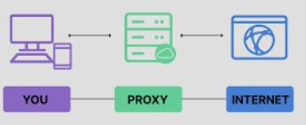
What is a Proxy?
A proxy is an intermediary server between a client and another server.
Proxies help with security, caching, traﬃc control, and anonymity.
Two main types: Forward Proxy & Reverse Proxy.

Slide 3
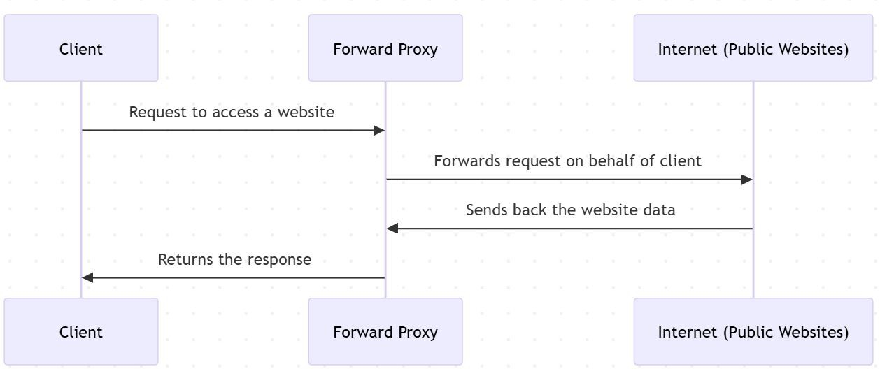
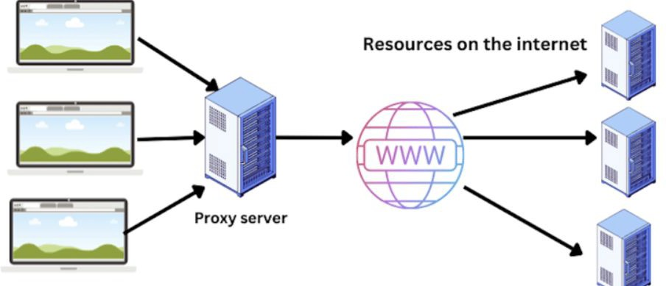
What is a Forward Proxy?
Sits between a client and the internet (used by clients).
Clients connect to the forward
proxy instead of directly accessing websites.
Can ﬁlter content, provide anonymity, and cache requests.
Common use cases:
  Bypassing geo-restrictions
  Anonymous browsing (VPNs, TOR)
  Caching web pages for faster access

Slide 4
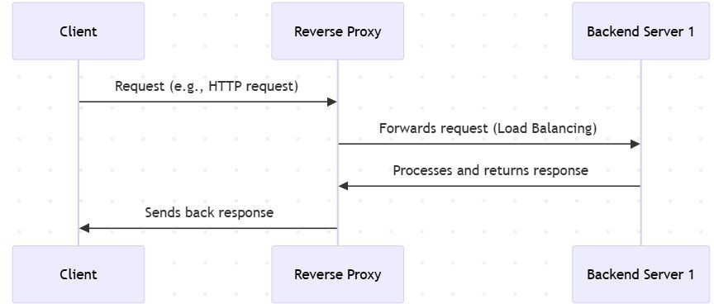
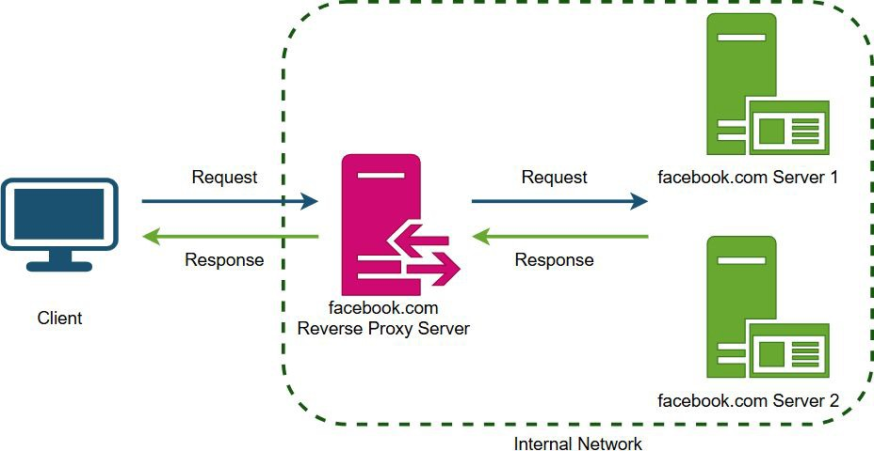
What is a Reverse Proxy?
Sits between users and backend servers (used by servers).
Clients don’t directly communicate with backend servers—requests go through the reverse proxy.
Used for load balancing, caching, security, and SSL termination.
Common use cases:
  Load balancing across multiple servers
  Caching content to improve speed
  DDoS protection & security

Slide 5
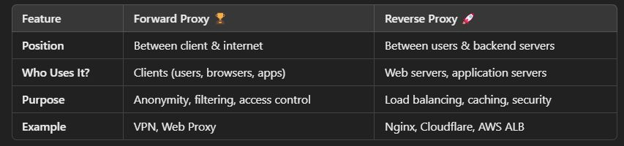
Key Differences - Forward vs. Reverse Proxy

Slide 6
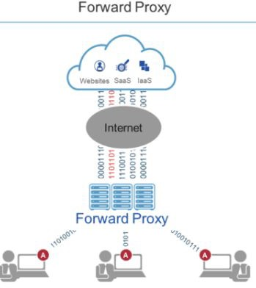
Use Cases for Forward Proxy
Privacy & Anonymity (Hides user IP)
Content Filtering (Restrict certain websites)
Bypass Geo-restrictions (Access region-blocked content)
Caching (Reduce redundant requests, speed up browsing)

Slide 7
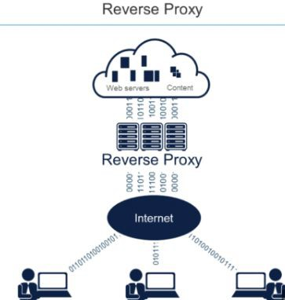
Use Cases for Reverse Proxy
Load Balancing (Distribute traﬃc to multiple servers)
Security & DDoS Protection (Hide backend servers, block attacks)
SSL Termination (Oﬄoad SSL processing to proxy)
Caching & Compression (Reduce load on backend servers)

Slide 8
Interview Questions on Forward Proxy vs. Reverse Proxy
Basic Concepts
  What is a proxy server, and why is it used?
  Explain the key diﬀerences between a forward proxy and a reverse proxy.
Technical Deep Dive
  How does a forward proxy improve security and privacy?
  How does a reverse proxy help in load balancing and caching?
  What are some real-world examples of forward and reverse proxies?
Implementation & Use Cases
  When should you use a forward proxy vs. a reverse proxy in system architecture?
  What are some common tools and technologies used for each type of proxy?
  How does a reverse proxy protect backend servers from DDoS attacks?
Advanced Topics
  How does SSL termination work in a reverse proxy?
  What are the advantages of using Cloudﬂare, Nginx, or HAProxy as a reverse proxy?
  How does a transparent proxy diﬀer from a forward or reverse proxy?

Slide 9
Wrap-Up & What’s Next?
Key Takeaways:
  A forward proxy helps clients interact with the internet securely.
  A reverse proxy protects and optimizes backend servers.
  Understanding proxy usage helps in designing scalable & secure architectures.
Next Topic:
  Load Balancers

